Slide 1

SPI Implementation on EZ-USB

Slide 2
Overview
SPI Overview
SPI Peripherals
Two methods to implement on EZ
Comparison
Wrap-up

Slide 3
SPI Overview
Four wire interface
  Chip Select
  Clock
  Data Out (Master -> Peripheral)
  Data In (Peripheral -> Master)
Synchronous
Data shifted out falling edge CLK
Data shifted in rising edge CLK

Slide 4
SPI Peripherals
EEPROMS
MMC (Multi-Media Cards)
A/D converters
Keyboard scanners
Power switches
Real time clocks
Digital potentiometers

Slide 5
Software Implementation
Two assembly routines (write, read)
  Shifts a bit in/out and toggles clk
  Can use any port pins
  Uses read-modify-write and movx
  Flexible byte size
  Shifts MSB first

Slide 6
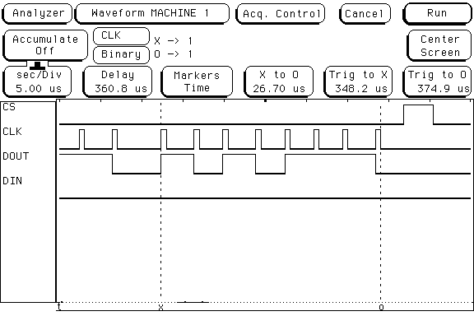
Write Routine
_spiwritebyte:
mov DPTR,#OUTC ;point to outc
mov R6, #8 ;set up loop
loop:
mov A, R7 ;move data to send to A
rlc A ;rotate left through carry
mov R7, A ;save rotated
movx A, @DPTR ;setup to change bit
jc highbit ;if bit is high jump
anl A, #BITLOW ;else set bit low
sjmp skip ;skip setting bit high
highbit:
orl A, #BITHIGH ;set out high and clock
skip:
orl A, #CLKHIGH ;set clock bit high
movx @DPTR, A ;output data
; nop ;may need this to stretch clock high time
anl A, #CLKLOW ;set clock low
movx @DPTR, A ;output low clock
djnz R6, loop ;repeat eight times
ret
end

Slide 7
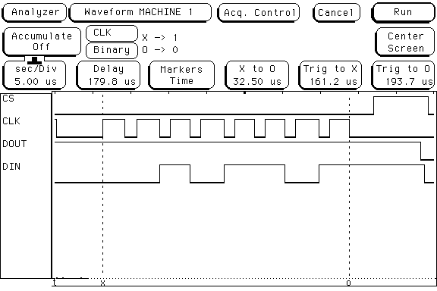
Read Routine
spireadbyte:
mov DPTR,#OUTC ;point to outc
movx A,@DPTR ;read outc
mov R4,A ;save outc
orl A,#CLKHIGH ;set clock high byte
mov R5,A ;save contents of clkhigh
mov A,R4 ;read outc
anl A,#CLKLOW ;set clock low byte
mov R4,A ;save contents of clklow
inc DPS ;switch pointer 1
mov DPTR,#PINSC ;point second pointer to pinsc
inc DPS ;switch pointer 0
mov R6,#8 ;set up loop
loop:
mov A, R5 ;get contents of clkhigh
movx @DPTR, A ;output data
inc DPS ;switch pointer 1
movx A,@DPTR ;read in port c
anl A,#BITMASK ;mask off input pin
jnz highbit ;if result is not zero
clr c ;clear carry
sjmp skip ;skip carry set
highbit:
setb c ;set carry
skip:
inc DPS ;switch pointer 0
mov A,R4 ;get contents of clklow
movx @DPTR,A ;output low clock
mov A,R7 ;move byte into A
rlc A ;rotate bit in
mov R7,A ;save new byte
djnz R6,loop ;repeat eight times
ret
end

Slide 8
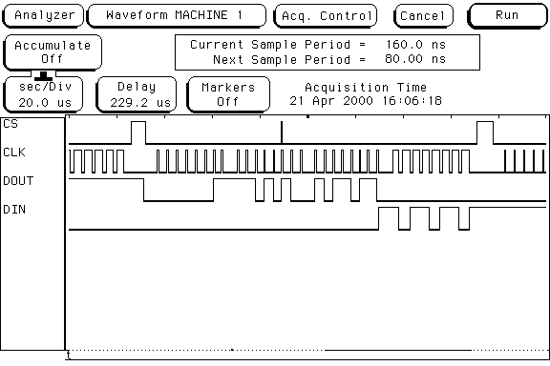
Test Sequence
C Program calls routines to talk to EEPROM
Can modify to use any protocol, pins, or byte length

Slide 9
UART Mode 0 Implementation
Can use either UART
Two baud rates (CLK24/4 or CLK24/12)
Shifts LSB first (!)
Simple setup
Low software overhead
Half-duplex only

Slide 10
Initialization
SCON
  Mode 0 so SM0 = SM1 = 0
  Baudrate SM2 = 0 (CLK24/12)
  Receive Enable REN = 1
  Interrupt Flags TI = RI = 1
Alternate Functions
  Need RxD, TxD (PORTCCFG)
  Need RxDOUT (PORTACFG)

Slide 11

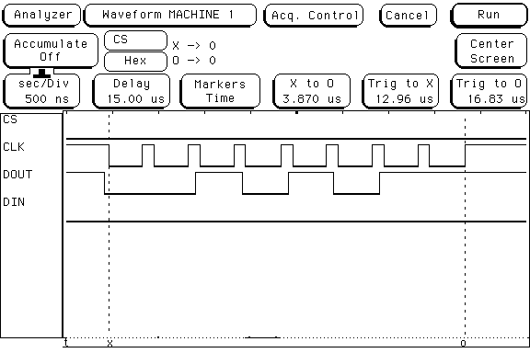
Write Sequence
Clear TI flag
Write to SBUF (starts transfer)
Wait until TI flag set
void spiwritebyte (BYTE d)
{
TI = FALSE; //Clear flag
SBUF0 = swap[d]; //Write byte
while (!TI); //Wait until done transmitting
}

Slide 12

Read Sequence
Clear RI flag (starts reception)
Wait until RI flag set
Read SBUF
BYTE spireadbyte (void)
{
RI = FALSE; //Clear flag
while (!RI); //Wait until done receiving
return (swap[SBUF0]); //Return byte
}

Slide 13
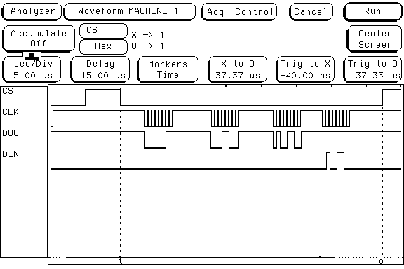

Putting it together
Same C code as other example

Slide 14

What is that SWAP thing
Most SPI peripherals want MSB first, but UART Mode 0 does LSB first!
Easy, fast solution is to have a look-up table (array in C code)
code BYTE swap[] = {0,128,64,192,32,160,96,224,16,144,80,208,48,176,112,240,8,136,
72,200,40,168,104,232,24,152,88,216,56,184,120,248,4,132,68,196,36,164,100,
228,20,148,84,212,52,180,116,244,12,140,76,204,44,172,108,236,28,156,92,220,
60,188,124,252,2,130,66,194,34,162,98,226,18,146,82,210,50,178,114,242,10,
138,74,202,42,170,106,234,26,154,90,218,58,186,122,250,6,134,70,198,38,166,
102,230,22,150,86,214,54,182,118,246,14,142,78,206,46,174,110,238,30,158,94,
222,62,190,126,254,1,129,65,193,33,161,97,225,17,145,81,209,49,177,113,241,9,
137,73,201,41,169,105,233,25,153,89,217,57,185,121,249,5,133,69,197,37,165,
101,229,21,149,85,213,53,181,117,245,13,141,77,205,45,173,109,237,29,157,93,
221,61,189,125,253,3,131,67,195,35,163,99,227,19,147,83,211,51,179,115,243,11,
139,75,203,43,171,107,235,27,155,91,219,59,187,123,251,7,135,71,199,39,167,
103,231,23,151,87,215,55,183,119,247,15,143,79,207,47,175,111,239,31,159,95,
223,63,191,127,255};

Slide 15
Comparison
Software SPI
  Slow
  High software overhead
  Flexible byte lengths
  Flexible timing
  Can be full duplex
  MSB or LSB first
  Use any port pins
UART Mode 0
  Fast
  Low software overhead
  Fixed byte length
  Fixed timing
  Only half duplex
  Only LSB first
  Uses one UART

Slide 16
Wrap-Up
SPI is easy interface to implement
SPI supported by many peripherals
Few different ways to implement with tradeoffs

